Slide 1
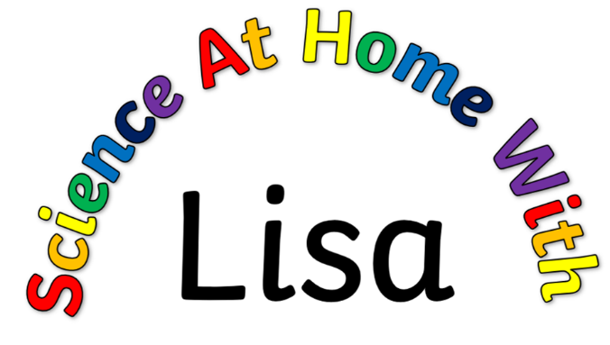
The Story of DNA a timeline of scientists

Slide 2

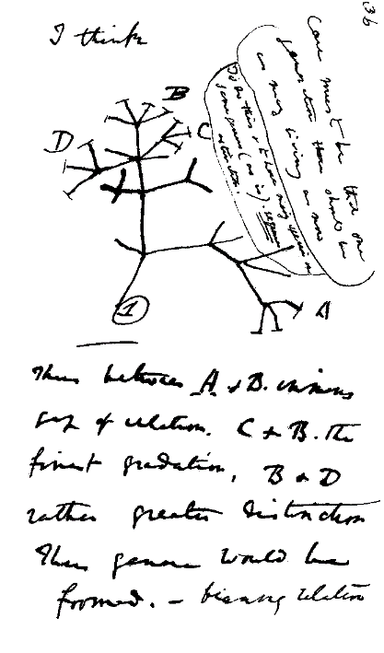
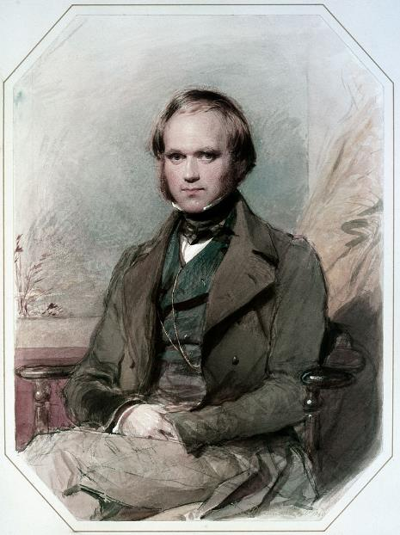
1859 - Charles Darwin
Studied many different types of wildlife, from beetles to barnacles in the UK, to the famous finches & tortoises of the Galapagos Islands.
Realised that naturally occurring variations between individuals made some more like to survive & breed than others. This, over many generations, lead to changes in species: what we know as evolution.
His work is often summarised as ‘survival of the fittest’.
Darwin portrait public domain. Notebook image public domain

Slide 3
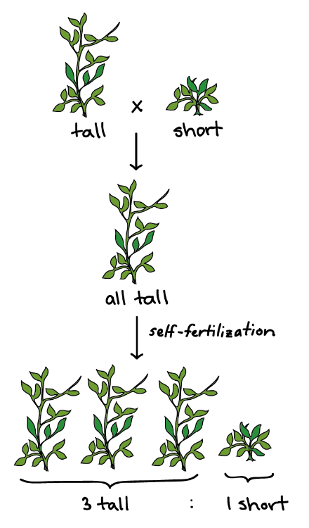
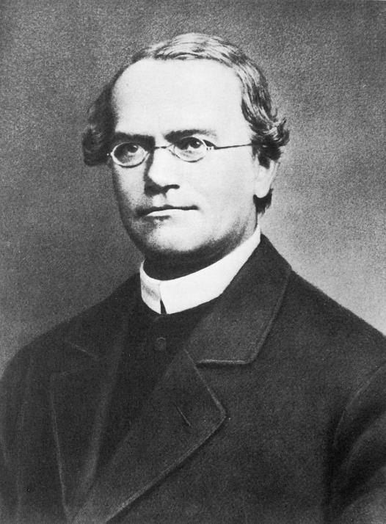
1866 - Gregor Mendel
Bred pea plants
Crossed 2 types of parent:
1st generation all had the same trait, but 2nd generation had some with the other trait too. Ratio was always 3:1.
Invented the idea of genetics, and the terms dominant and recessive
Work not recognised until much later
Mendel portrait public domain. Pea diagram from Khan Academy

Slide 4
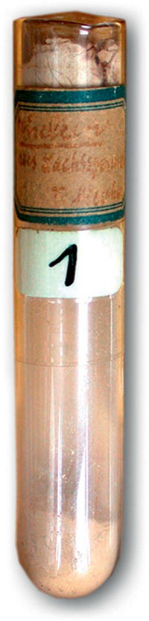
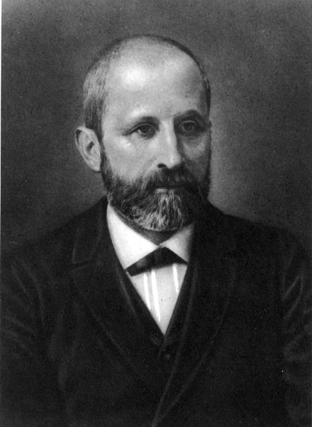
1869 – Friedrich Miescher
A Swiss chemist, he studied the pus from hospital bandages (!) to find out more about the proteins inside white blood cells.
Discovered an entirely new type of molecule that contained lots of phosphorus and was not a protein.
He called it nuclein.
It would be decades before other scientists realised its importance. We now call it DNA.
Miescher portrait public domain. Photo of nuclein sample public domain

Slide 5
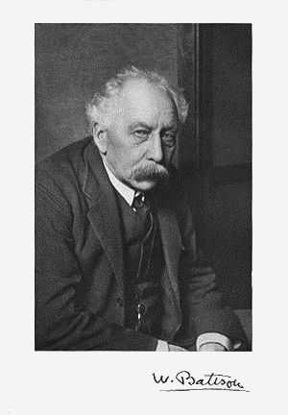
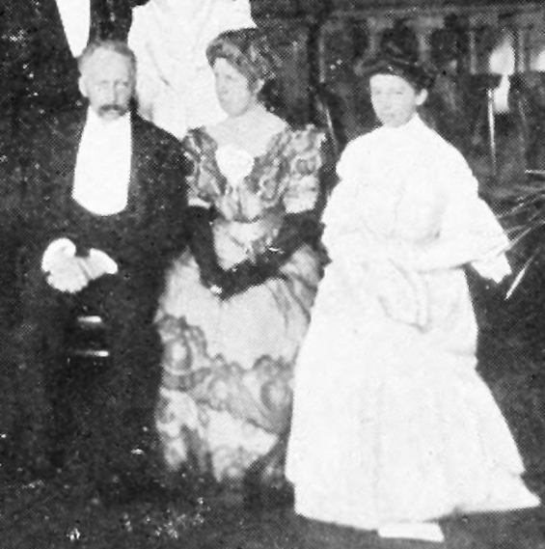
1905 – William Bateson
Bateson led a group of researchers at Newham College, Cambridge (mostly women – very unusual at the time) who did research into how characteristics were passed from parent to offspring.
His work led to the rediscovery of Mendel’s work.
He invented the word genetics in 1905, from the Greek word genno meaning ‘to give birth’.
Both photos – public domain. Group is Bateson, his wife & her sister: both active researchers

Slide 6
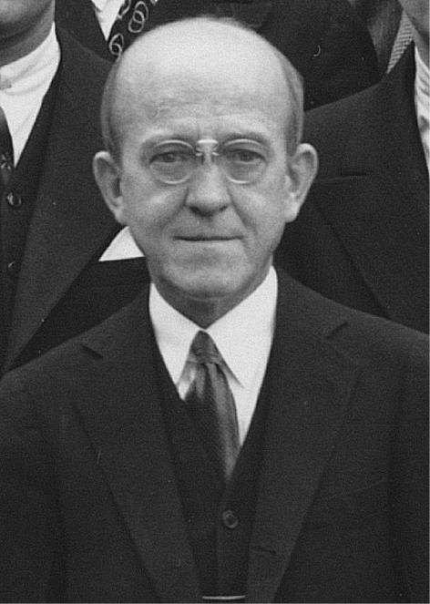
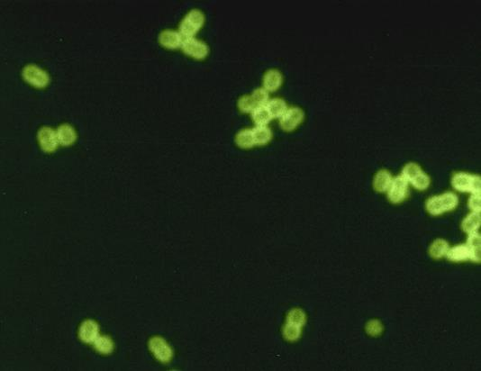
1944 – Oswald Avery
Working with the bacteria that can cause pneumonia, Oswald proved that it was the DNA in cells that carried information from parent to offspring.
Before this, scientists had assumed that the information was carried by proteins.
Avery photo - Rockefeller Institute for Medical Research. Streptococcus image public domain from Centers for Disease Control and Prevention's Public Health Image Library

Slide 7
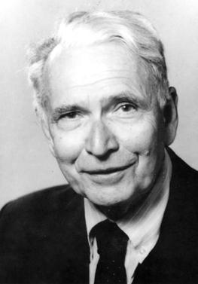
1950 – Erwin Chargaff
Born in Austria-Hungary, Chargaff worked in France, America and Germany, but moved permanently to America after the rise of Adolf Hitler: Chargaff was Jewish.
He discovered that the detailed make-up of DNA was slightly different for every species.
He also found that for any species, there was always the same amount of Adenine as Thymine, and the same amount of Guanine as Cytosine.
This was a vital clue to discovering the structure of DNA, although Chargaff himself didn’t directly suggest the A-T and C-G bonding.
In 1952, he chatted informally about his work with two other scientists – James Watson & Francis Crick…
Photo of Chargaff – available for Fair Use

Slide 8
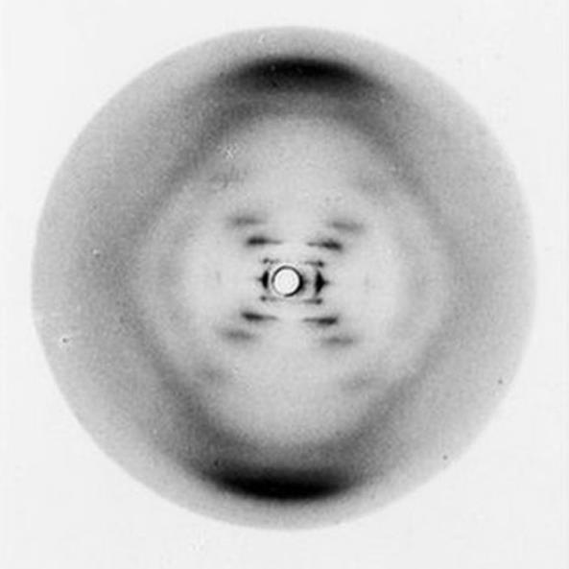
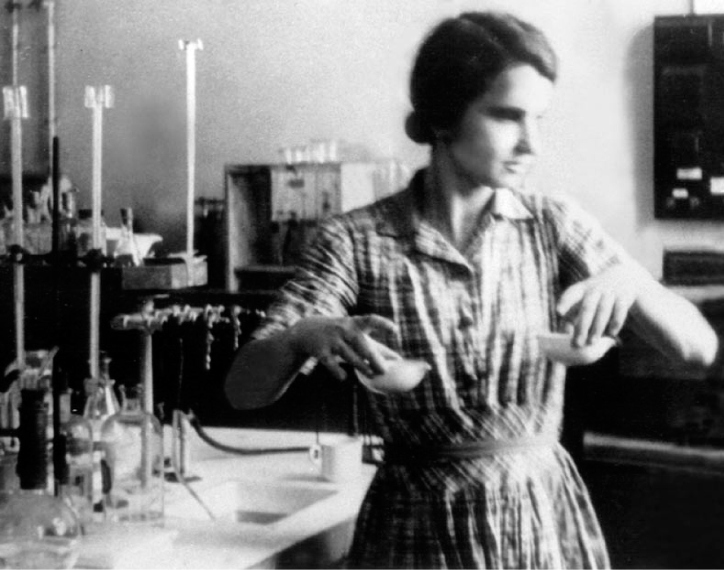
1952 – Rosalind Franklin
Working alongside Maurice Wilkins, and with a student, Raymond Gosling, she used x-rays to take photographs of pure crystals of molecules, including DNA.
The X-shape showed that the molecule was a helix. The distance between the bars showed the size of the gaps between the ‘base pairs’. The pattern also indicated that the phosphate/sugar chain was on the outside of the molecule.
In 1953, Wilkins showed Photo 51 to James Watson, without Franklin’s knowledge.
Franklin – Vittorio Luzzati, Photo 51 – King’s College

Slide 9
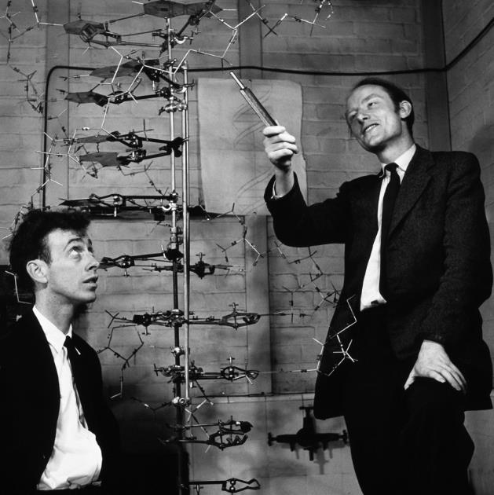
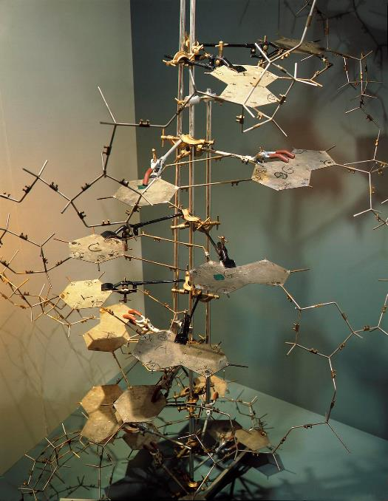
1953 – James Watson & Francis Crick
Using Chargaff’s work on the A-T and C-G ratios, and information from Franklin’s photo 51, Watson & Crick built models to work out the structure of DNA.
In February 1953, they found the correct model. Excited, they announced their findings to colleagues having lunch in The Eagle pub in Cambridge!
In 1962, they were awarded the Nobel Prize, along with Wilkins. Franklin did not receive the prize because she died in 1958, from cancer.
Crick on left, Watson on right – pic Uni of Cambridge. Model – Science Museum

Slide 10
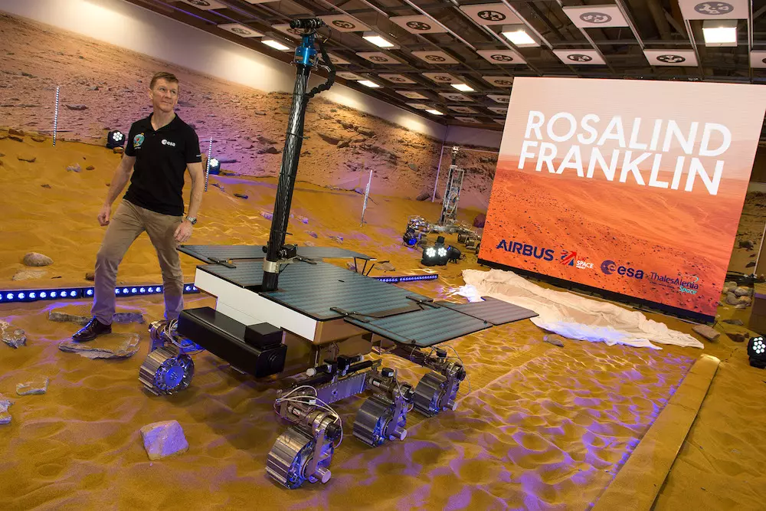
Post script …
The next rover to be sent to planet Mars will be searching for signs of life.
It is called …
Rosalind Franklin
image © Airbus/ Max Alexander

